Slide 1






Spark Streaming & Kafka
Uber Use Case
Alex L
Alex S Eric G
Kwaku Danso-Man
FEBRUARY 18, 2019

Slide 2



Agenda
Context
Scope
Optimize Locations
Goal
Historical Uber Data
Data
Clustering & Streaming
Techniques
Demonstration
Results
Scope

Slide 3
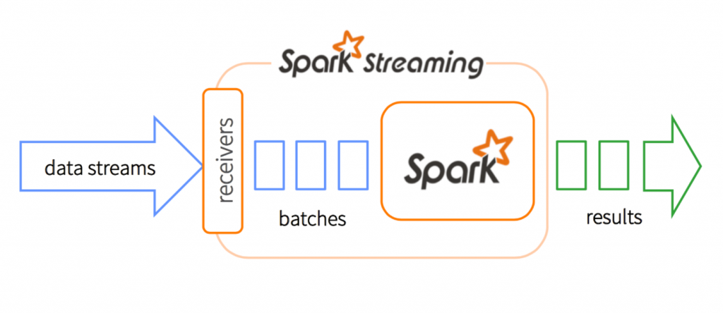
Conceptual Foundation : Spark Streaming
Process real-time data from various sources including Kafka, Flume, HDFS, Amazon Kinesis etc.
Supports Java, Scala & Python
Seamlessly integrates with MLlib and Spark SQL

Slide 4
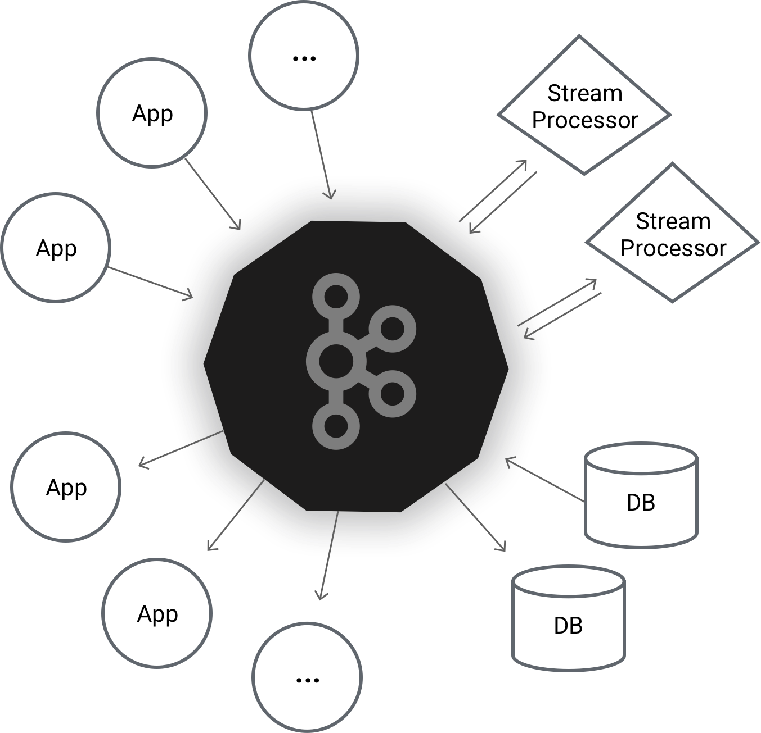
Conceptual Foundation : Apache Kafka
Distributed streaming platform
Integrates with Apache Spark for real-time streaming analysis
High throughput for both publishing and subscribing messages
Stable with TB’s of messages stored

Slide 5


An Influx of Connected IoT Devices
250 million connected cars by 2020
25GB of data per hour
GPS car data to optimize traffic flows
Price calculation and optimizing positions for profit by Uber
Source: https://www.gartner.com/imagesrv/books/iot/iotEbook_digital.pdf

Slide 6
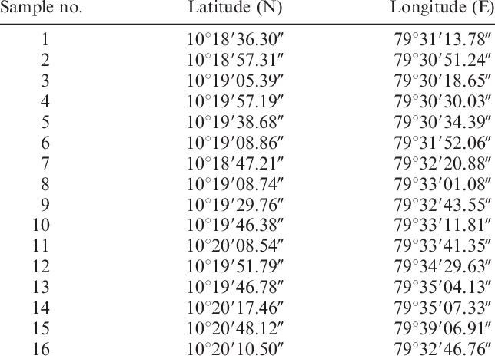



Processing Large Volumes of Real-Time Data
Explore Historical Data
Stream Real-Time Data
Find Optimal Spots
Analysis & Insights

Slide 7

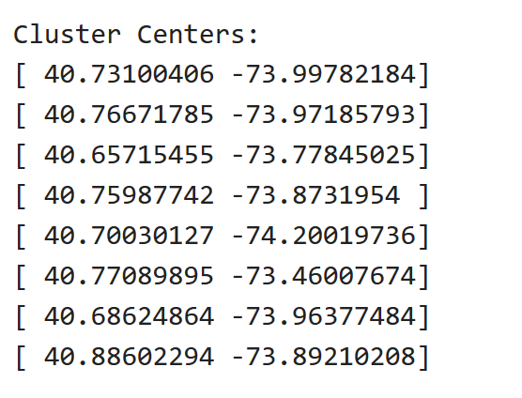



Finding The Spots with The Most Traffic
output
Location
object
K-Means Cluster

Slide 8







Stream Data with Apache Kafka
data stream
Consumer API
Zookeeper Server
Kafka Server
Uber Topic
Producer API

Slide 9


Slide 10
Thank You!

